Slide 1
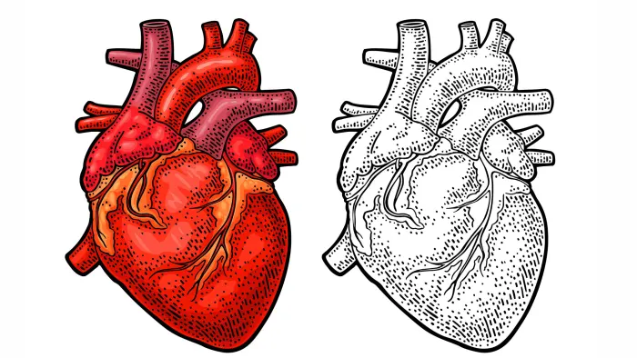
Heart Failure Prediction
Joyce Fang
March 2021

Slide 2
Background
Cardiovascular diseases are the #1 cause of death worldwide
~17.9m people die globally per year, accounting for 31% of all deaths*
Heart failure: occurs when the heart is unable to supply enough blood to meet the body’s needs
“Machine learning can predict survival of patients with heart failure from serum creatinine and ejection fraction alone.” BMC Medical Informatics and Decision Making. 03 February 2020.
Notes:
Modeling survival for heart failure (and CVDs in general) is still a problem nowadays, both in terms of achieving high prediction accuracy and identifying the driving factors
modest accuracy
becoming a new supporting tool for physicians when predicting if a heart failure patient will survive or not
serum creatinine and ejection fraction as the two most relevant features

Slide 3
What features should doctors focus on most to accurately predict a patient’s survival after heart failure?

Slide 4
Dataset
299 patients with heart failure collected in 2015
203 patients survived
96 patients died- 32%
All patients experienced previous heart failures
Data collected from patients based in Pakistan
13 features
Age: 40-95
Anaemia – deficiency of red blood cells—reduced oxygen flow to organs
Creatinine_phosphokinase - CPK flows into the blood when muscle tissue gets damaged
Diabetes
Ejection_fraction - % of blood pumped out by the left ventricle with each contraction
High_blood_pressure
Platelets - Number of platelets in blood
Serum_creatinine – waste product generated by creatine when a muscle breaks down
Serum_sodium - level of sodium in blood (mEq/L); low levels could be caused by heart failure
Sex – 105 women, 194 men
Smoking
Time - follow-up period in days
DEATH_EVENT – target variable that states if a patient died or survived before the end of the follow-up period (130 on average)

Slide 5
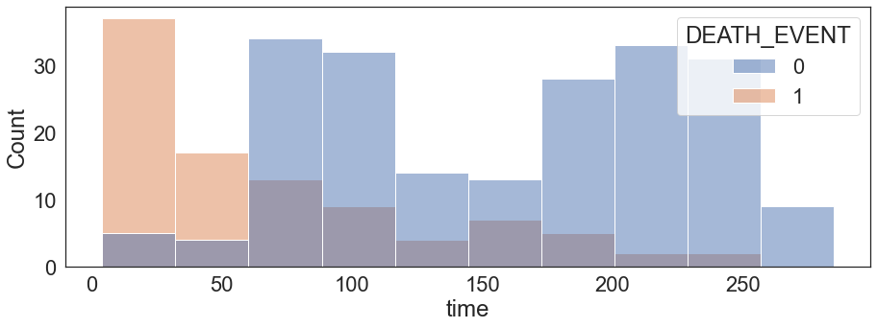
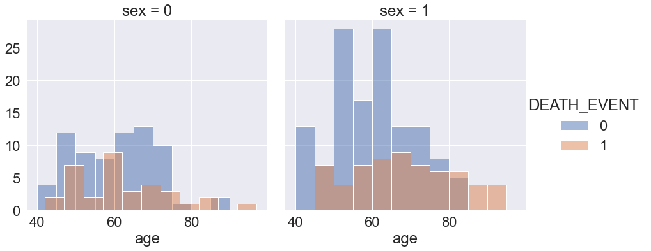
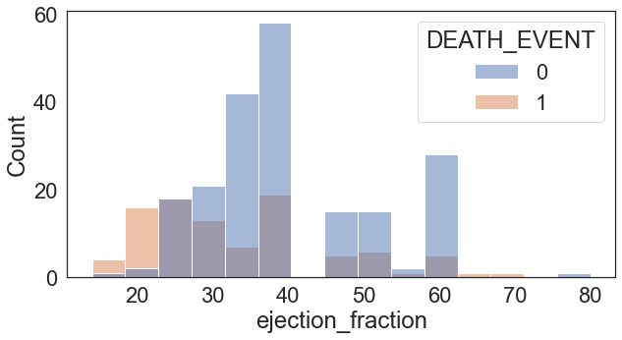
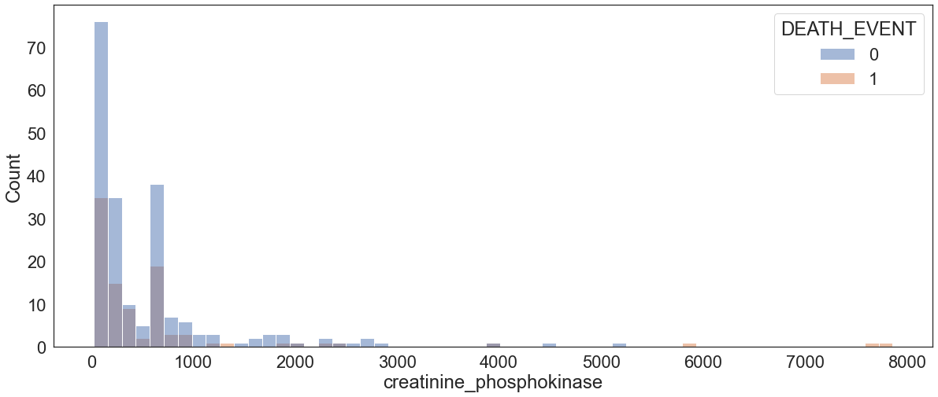
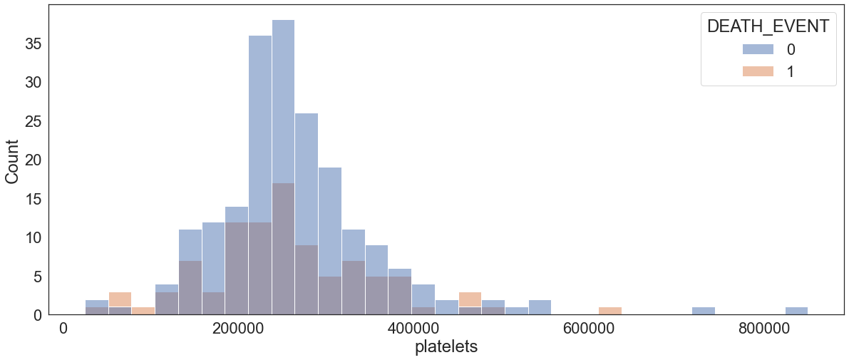
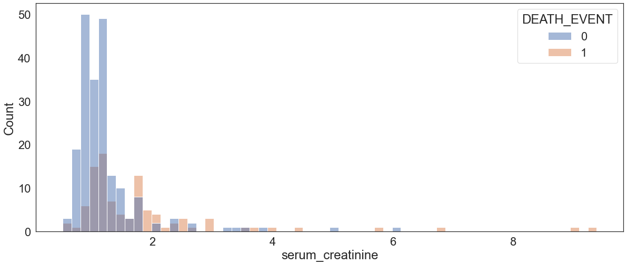
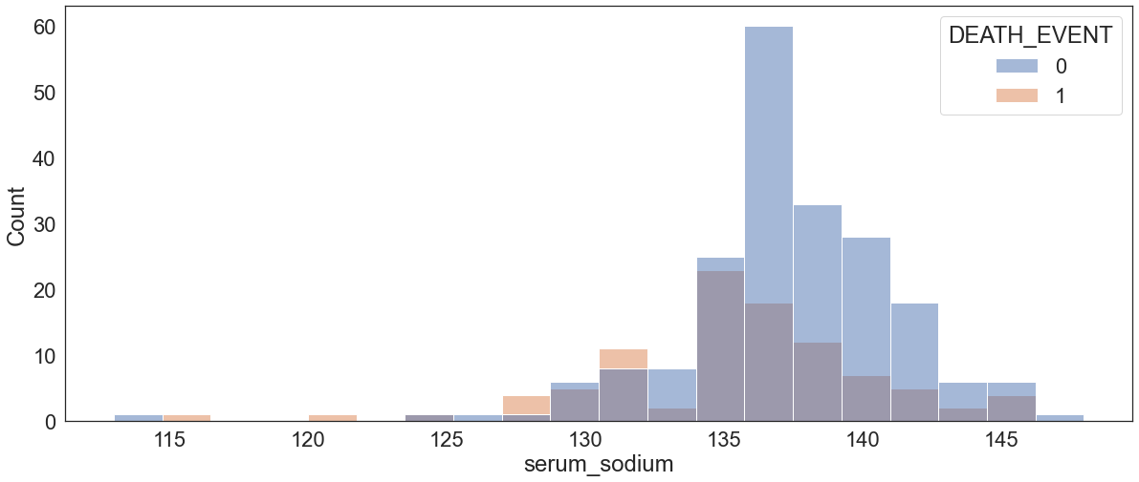
Non-Binary Features
Notes:
Age: 40-95
Sex – 105 women (0), 194 men (1)
Pretty evenly distributed
Creatinine_phosphokinase - CPK flows into the blood when muscle tissue gets damaged
High levels indicate possible heart failure or injury
More patients have lower levels of CPK, so proportionally, more deaths with more common CPK levels
Might not be an important indictor
Serum_creatinine – waste product generated by creatine when a muscle breaks down
Indicates renal dysfuction if high
Sort of more normally distributed deaths compared to survivors
More skewed to the left for the patients who died
Time - follow-up period in days
Interesting because maybe doctors already identified these patients as higher risk so their follow up period duration was shorter
Dataset didn’t indicate what the followups were for
Ejection_fraction - % of blood pumped out by the left ventricle with each contraction. Normal is 50-70%
makes sense that patients with lower EF died than survived
Platelets - Number of platelets in blood
normal distribution so might not be as important a factor
Serum_sodium - level of sodium in blood (mEq/L); low levels could be caused by heart failure. Normal is 135-145 mEq/L (miliequivalents/liter)
Mineral needed for correct functioning of muscles and nerves
Survivors – skewed left

Slide 6
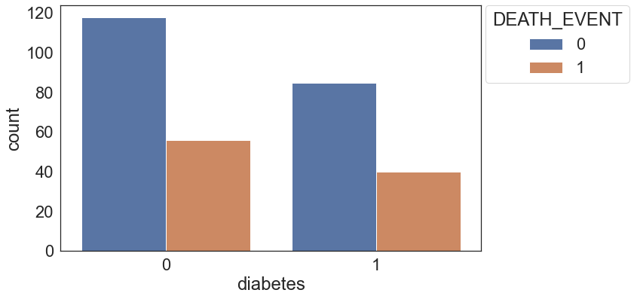
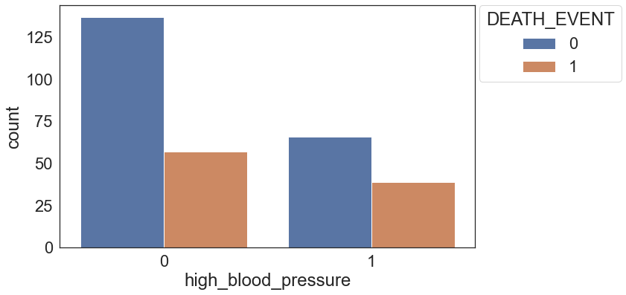
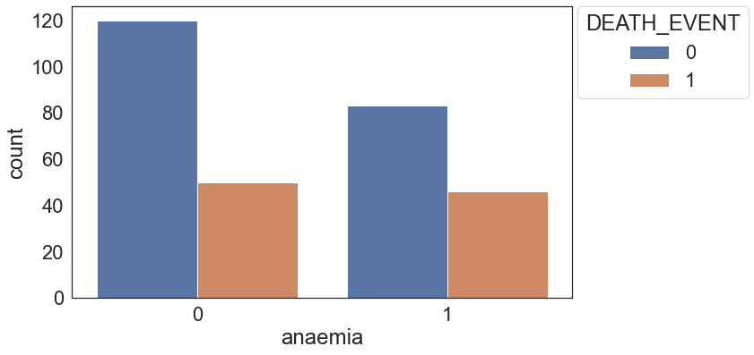
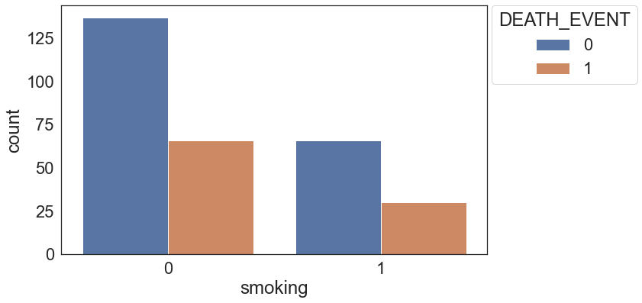
Binary Features
Notes:
Anaemia – deficiency of red blood cells—reduced oxygen flow to organs
High_blood_pressure
Diabetes
Smoking
DEATH_EVENT – target variable that states if a patient died or survived before the end of the follow-up period (130 on average)
For each feature, for each category or having vs not having, it seems that the ratio of the patients who died is 1:3 or about 30%--interesting ratio
Could be an indicator that they’re not as important features

Slide 7
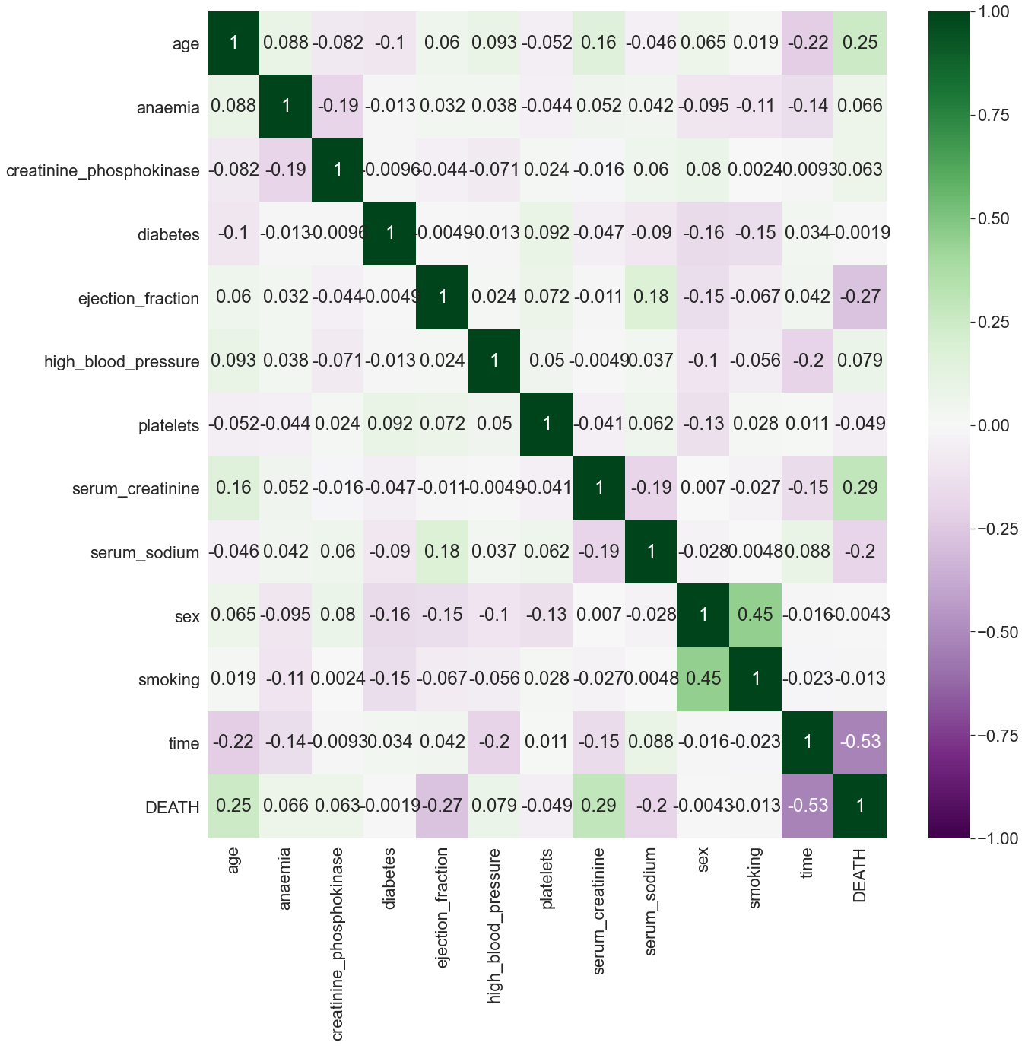
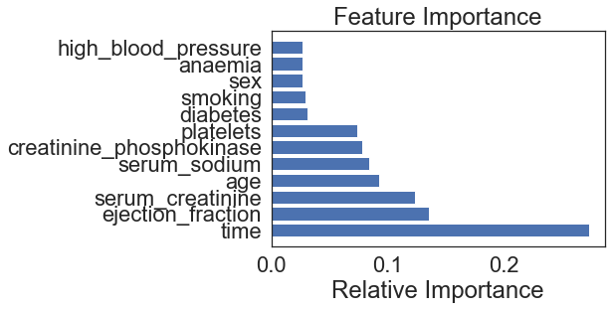
Feature Selection
Age
Serum_creatinine
Ejection_fraction
Time
Serum_sodium
Notes:
Correlation heatmap
- serum_sodium -0.20
- age 0.25
- ejection_fraction -0.27
- serum_creatinine 0.29
- time -0.53
Feature Importance using ExtraTreesClassifier
Serum_sodium
Age
Serum_creatinine
Ejection_fraction
Time

Slide 8
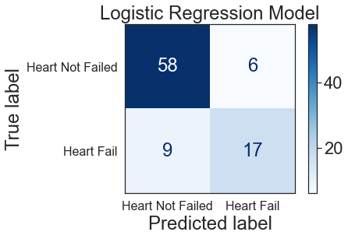
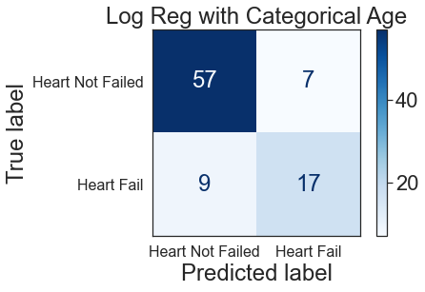
5 Features
Accuracy on test data: 83.3%
Accuracy on test data: 82.2%
Notes:
Serum_sodium
Age
Serum_creatinine
Ejection_fraction
Time

Slide 9
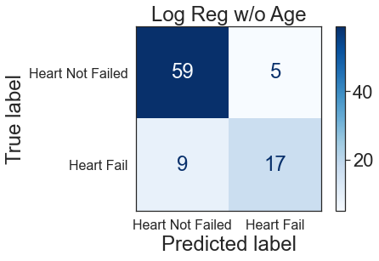
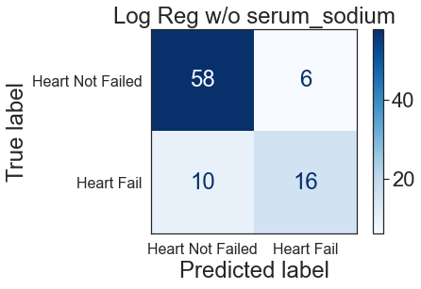
Dropped Age & Serum_sodium
Accuracy on test data: 84.4%
Accuracy on test data: 82.2%
Dropped Age
Kept serum_sodium

Slide 10
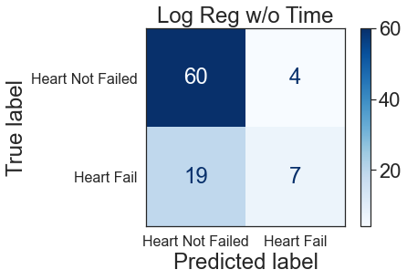
Drop Time
Accuracy on test data: 74.4%
Kept time
Notes:
-time is important because doctors probably schedule earlier followups for patients with more severe situations
-however, the dataset didn’t indicate what the followups were for (i.e. regular checkup, etc.)

Slide 11

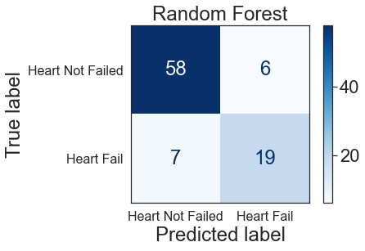
Best Hyperparam & Random Forest
Accuracy on test data: 81.1%
Accuracy on test data: 85.6%
Notes:
-at this point, 4 features:
Serum_sodium
Serum_creatinine
Ejection_fraction
Time

Slide 12

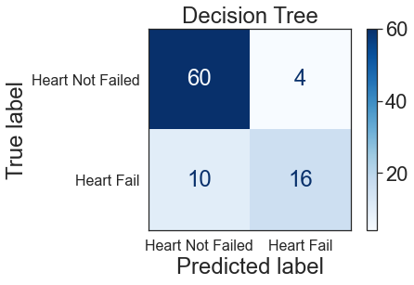
Gboosting & Decision Tree
Accuracy on test data: 81.1%
Accuracy on test data: 84.4%

Slide 13
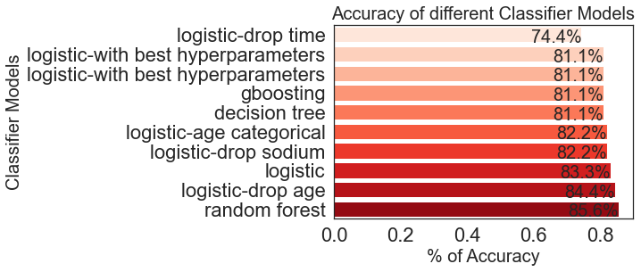
Model Accuracy Scores Comparison
Notes:
Based on 4 features:
Serum_sodium
Serum_creatinine
Ejection_fraction
Time

Slide 14
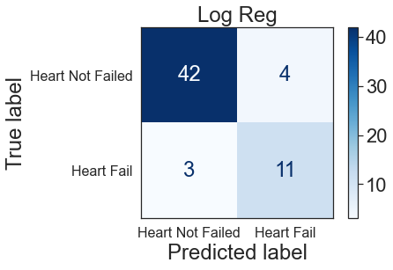
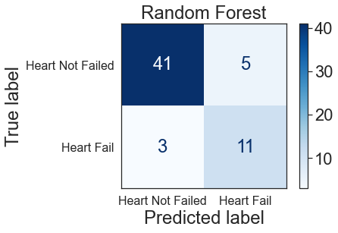
80-20 Split?
Accuracy on test data: 88.3%
Accuracy on test data: 86.7%
BUT
Accuracy on train data: 100%

Slide 15
Article’s Findings
serum creatinine and ejection fraction are the most predictive clinical features of the dataset, and are sufficient to predict patients’ survival
Random forest/gradient boosting – 58.5% accuracy
New supporting tools for physicians to predict survival based easily accessible info that are usually available on a patient’s electronic health record (EHR)
Notes:
Time isn’t a clinical feature
For new patients, doctors only have clinical features to base off of
And of the 3 that’s left, serum_sodium is definitely not as important
So without time, the accuracy of the model decreases significantly, but in a clinical setting, it makes sense that taking into account only serum creatinine and ejection fraction might be enough to predict a patient’s survival
Feature Ranking
Biostatistics tests (Man-Whitney, Pearson correlation coefficient and chi squared test) to identify serum creatinine and ejection fraction as top two most important features
Random forest feature ranking
Survival machine learning prediction on serum creatinine and ejection fraction alone
100 executions
70-30 but different balance ratios for each execution
Random forest and gradient boosting – 58.5%
Also SVM radial

Slide 16
Conclusions
Data limitations
Small size
Additional physical features (height, weight, etc.)
Different geographic region
More models and their hyperparameters
Feature ranking
Notes:
Feature Ranking
Biostatistics tests (Man-Whitney, Pearson correlation coefficient and chi squared test) to identify serum creatinine and ejection fraction as top two most important features
Random forest feature ranking

